Slide 1


TECH TITIANS (CN127) PRESENTS :-
SPAM EMAIL DETECTION (ML101)
Prepared By: SAGAR, HARMEET, MANOHAR, JONAH

Slide 2
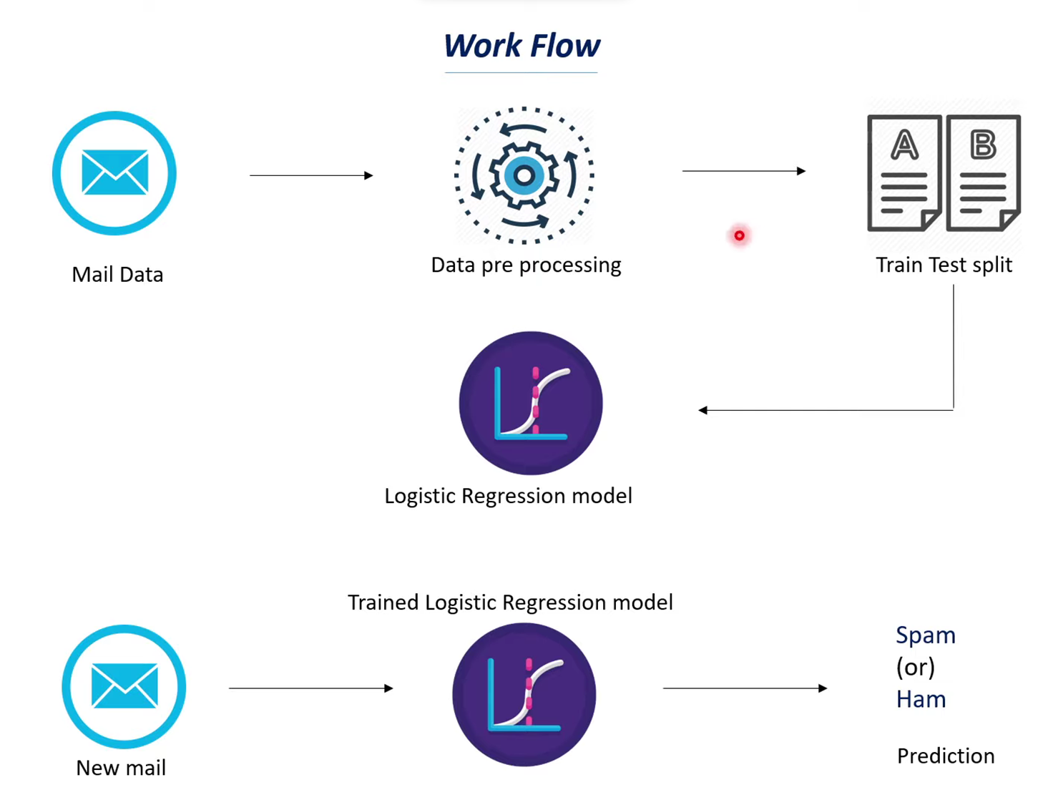

Slide 3

Spam Email Detection
Spam emails pose a significant threat in today's digital world, inundating inboxes and causing disruptions to personal and professional communications.
Detecting spam emails efficiently is crucial to maintaining a clutter-free inbox and protecting users from malicious content, phishing attacks, and scams.
Traditional rule-based filters have limitations in adapting to evolving spamming techniques and may result in false positives or negatives.
Machine learning (ML) algorithms offer a more adaptive and accurate solution to spam email detection by learning patterns from data and improving over time.

Slide 4

Problem: Developing a Spam Email Detection Algorithm
In today's digital age, the inundation of spam emails poses a critical challenge to email users. The objective of this project is to develop a machine learning algorithm capable of automatically detecting spam emails, thereby enhancing inbox management and mitigating security risks.
Traditional rule-based spam filters often falter in adapting to evolving spamming techniques, resulting in false positives and negatives. Moreover, the diversity of spam content and the constant evolution of tactics by spammers further compound the challenge.
Real-time detection is imperative to prevent spam emails from reaching users' inboxes promptly. Overcoming these challenges requires innovative approaches and robust machine learning models capable of effectively discerning spam from legitimate emails.

Slide 5
Data Preprocessing
Feature Engineering
Data Cleaning: Eliminate duplicates and irrelevant information from the dataset to ensure its quality and relevance for training the model.
Text Preprocessing: Employ tokenization to break down text into individual words or tokens. Normalize text by lowercasing to reduce word variations and handle special characters.
Vectorization: Utilize vectorization techniques such as TF-IDF to convert textual data into numerical form, enabling ML algorithms to process and the data effectively.
Word Frequency: Analyzing the frequency of words in emails to identify common patterns or spam-related terms.
Presence of Specific Keywords: Detecting the presence of known spam-related keywords or phrases indicative of spam content.
Structural Features: Examining structural aspects of emails such as sender information, email headers, and formatting, which may reveal spam-like characteristics.

Slide 6
Model Selection
Importance of Model Selection: Selecting an appropriate ML algorithm is crucial for achieving accurate and efficient spam email detection.
Candidate Algorithms: Consider various ML algorithms suitable for classification tasks, such as:
1. Support Vector Machines (SVM)
2. Logistic Regression

Slide 7

Understanding SVMs in Spam Email Detection
Purpose: SVMs are used for spam email detection, aiming to find the best hyperplane to separate spam from non-spam emails.
Model Function: SVMs classify emails into spam or non-spam categories by mapping them into a high-dimensional feature space and identifying the hyperplane that maximizes the margin between the two classes.
Kernel Trick: SVMs handle nonlinear classification problems using the kernel trick, which implicitly maps data into a higher-dimensional space. Common kernels include linear, polynomial, and radial basis function (RBF).
Advantages:
1. Effective with high-dimensional text-based data.
2. Robust to overfitting and imbalanced datasets.
3. Suitable for handling imbalanced data common in spam email detection.

Slide 8
Understanding Logical Regression in Spam Email Detection
Purpose: Logistic regression is used for binary classification tasks, predicting the probability of an input belonging to a specific class.
Model Function: It employs the logistic function (sigmoid function) to ensure output probabilities fall between 0 and 1, facilitating binary classification.
Parameter Optimization: Model parameters are optimized through techniques like gradient descent, minimizing the difference between predicted probabilities and actual outcomes during training.
Evaluation Metrics: Performance is assessed using metrics like accuracy, precision, recall, and F1-score, along with confusion matrices for deeper insights
Applications: Logistic regression finds widespread use in spam email detection due to its ability to model binary outcomes effectively, aiding in classifying emails as spam or non-spam based on their features.

Slide 9

Model Training
Model Evaluation
Training Process: The selected ML model is trained with preprocessed data, iteratively adjusting parameters to minimize the gap between predicted and actual outcomes.
Cross-Validation: training the model on some subsets and validating on others to estimate performance on unseen data.
Hyperparameter Tuning: It optimizes model performance and generalization by selecting optimal values for non-learned parameters (e.g., learning rate, regularization strength) using methods like grid search or random search.
Evaluation Metrics: Common metrics like accuracy, precision, recall, and F1-score assess the model's performance. Accuracy measures overall correctness, while precision, recall, and F1-score gauge its ability to classify spam and non-spam emails.
Accuracy: Accuracy measures the overall correctness of the model's predictions, indicating the proportion of correctly classified instances (both spam and non-spam) out of the total instances.

Slide 10

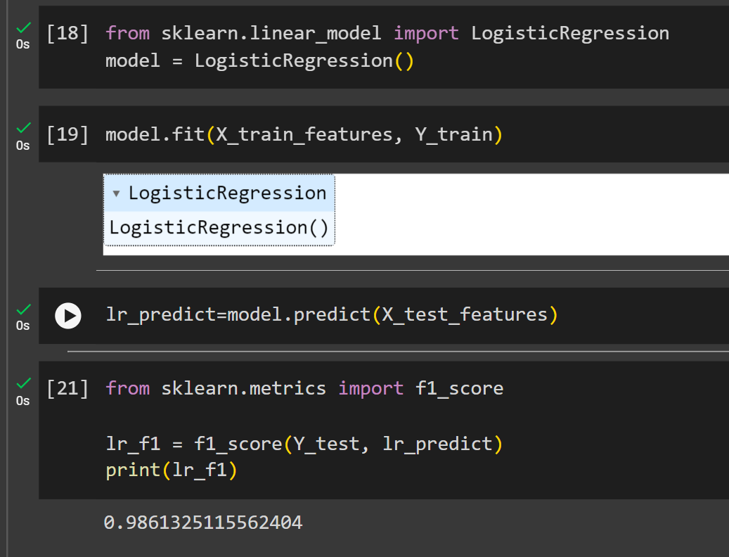
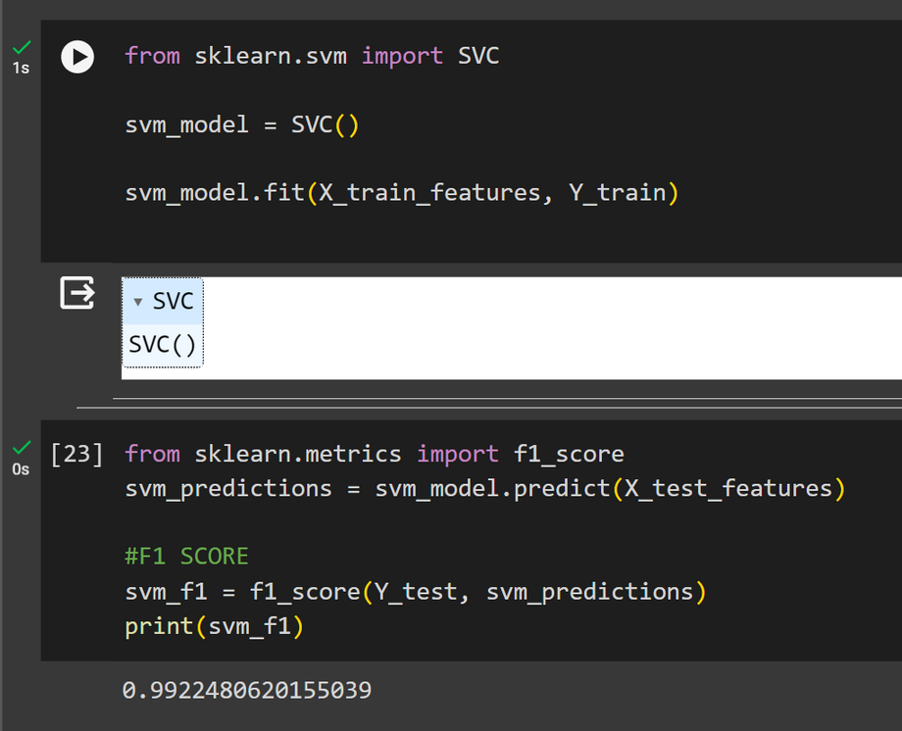
F1 Score
LOGISTIC REGRESSION
SVC

Slide 11
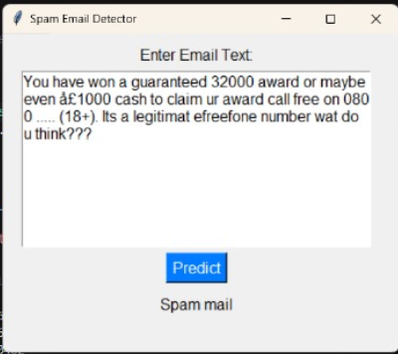
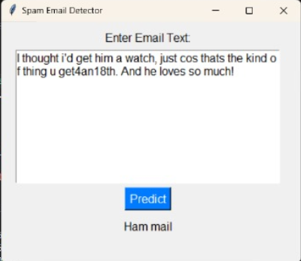

USER INTERFACE

Slide 12

Conclusion
In conclusion, integrating logistic regression and SVM offers a robust solution for spam email detection. By combining logistic regression's binary outcome modeling with SVM's capability in handling high-dimensional data, this approach provides effective classification. Incorporating evaluation metrics ensures reliability. Overall, this combined approach enhances email security by accurately identifying and mitigating spam, thus improving user experience.

Slide 13
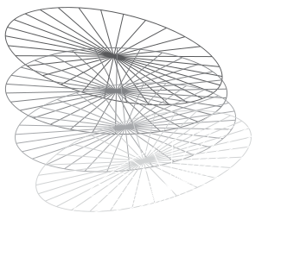
TEAM TITANS
THANK YOU

